Slide 1
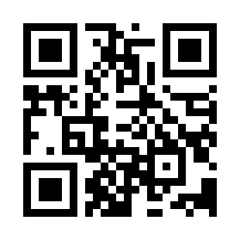
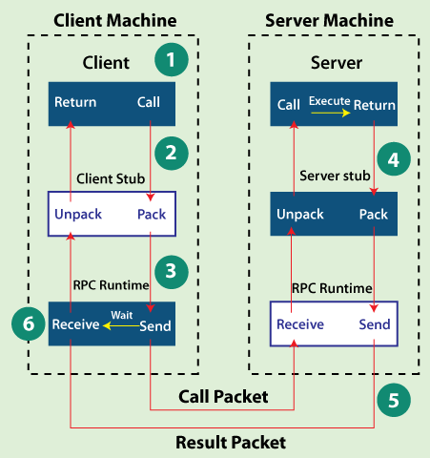
Remote Procedure Calls Quiz
https://bit.ly/40on270

